Slide 1
Lead Scoring Case Study
Submitted by : Sanket Garg

Slide 2
PROBLEM Statement
X Education sells online courses to professionals who visit their website. They market courses on various platforms. Visitors can explore courses, fill out a form, or watch videos. Those who provide contact details become leads. Leads also come from referrals. The sales team contacts leads via calls and emails. The conversion rate is about 30%.
Despite acquiring many leads, X Education wants to improve efficiency by identifying the most promising leads, called 'Hot Leads.' Focusing on these leads should increase the conversion rate and allow the sales team to prioritize communication with them.
We are give a data set with over 9000 points of data along with data dictionary, we are to make a logistic regression model for the above case to filter the hot leads based on score of 0 to 100

Slide 3
Data Understanding
We are given two files : Leads.csv and Leads data dictionary
‘Leads.csv’ contains around 9000 data points and the target variable is ‘Converted’ which is binary , where 0 indicates lead not converted and 1 indicates lead was converted
‘Leads Data Dictionary.xlsx’ file contains the data dictionary which explains each of the variables in ‘Lead.csv’

Slide 4
Analysis Approach
Data Preparation i)Cleaning dataset by removing null values, imputing missing values using 30% as threshold etc
Exploratory Data Analysis i)Analysis using univariate bivariate and multivariate analysis
Feature Selection i)Creating dummy variables ii)Making correlation Matrix and removing highly correlated variables using domain knowledge
Model Development
i)Applying logistic regression to predict the probability of leads being hot.
ii)Train the logistic regression model
iii)Removing variables using p and VIF values
iv) Evaluate the model's performance using appropriate metrics like accuracy, precision, recall, and F1-score.

Slide 5
Analysis Approach
Model Validation i)Validate the suitable model on test data set
ii)Check the model performance using evaluation metrics
Interpretation
i) Analysis of coefficient of logistic regression how each contribute to predicting the hot leads
ii)Identifying the top 3 variables that play a major role in predicting.
iv)Provide recommendation based on insights

Slide 6
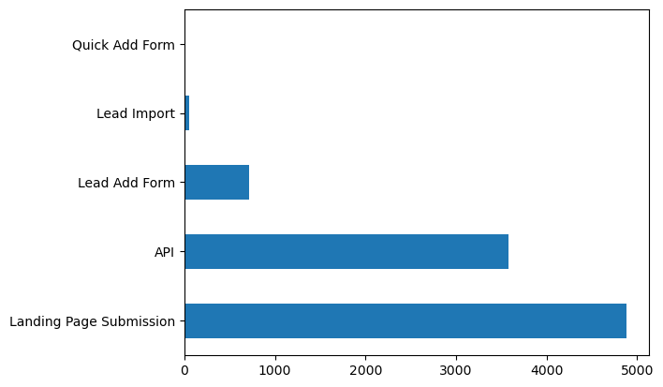
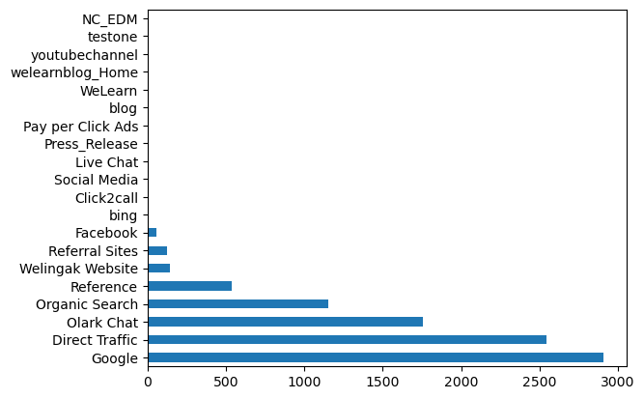
Univariate analysis
Lead Origin count
Lead Source Count
This shows that origin identifier with which the customer was identified to be a lead mostly done using API, Landing Page Submission and lead add form
The source of the lead mostly consist of Google, Direct traffic, Olark chat and Organic Search

Slide 7
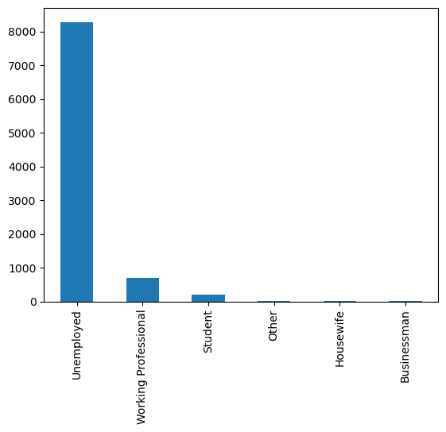
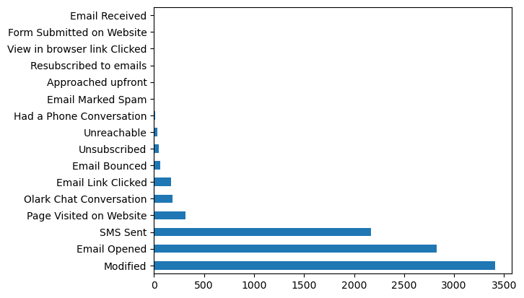
Univariate analysis
Occupation and their count
Last Notable Activity count
More than 8000 of the leads are unemployed and other significant are working professional and student
The last Notable activity among the leads are given where most of them are engaged in modification of details, viewing email or using SMS

Slide 8
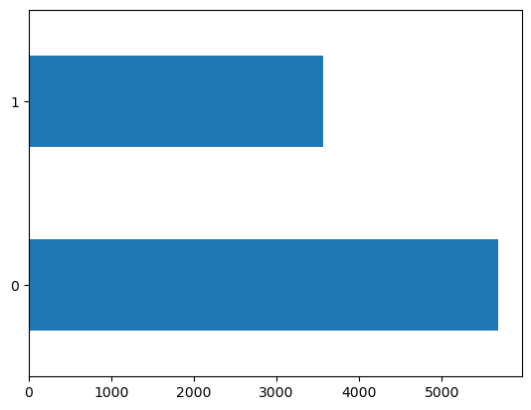
Checking data imbalance
There is small amount of imbalance , but this should be fine for making model
Zero implied the lead is converted and One not converted
The number of converted is around 3500 and not converted is above 5000
Count of converted and not converted

Slide 9
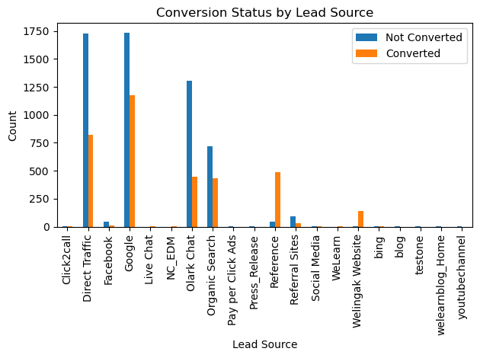
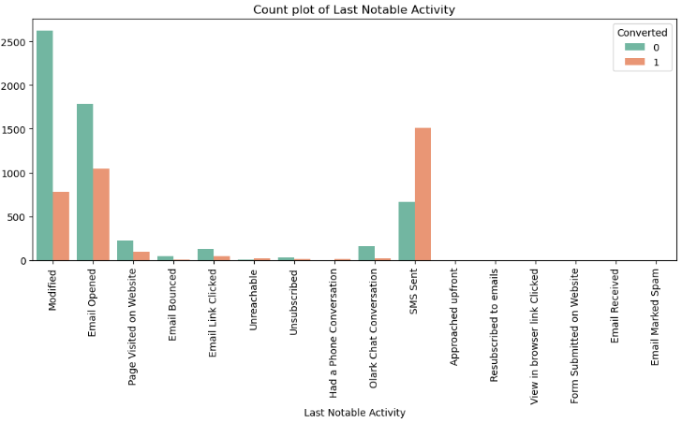
Bivariate analysis
Lead source is which has most conversion ratio by significant amount is shown by reference and Welingak website .
Conversion ratio for a lead whose SMS was sent recently seem to be higher.
Modified and email opened also show significant amount of converted however ratio remains low.

Slide 10
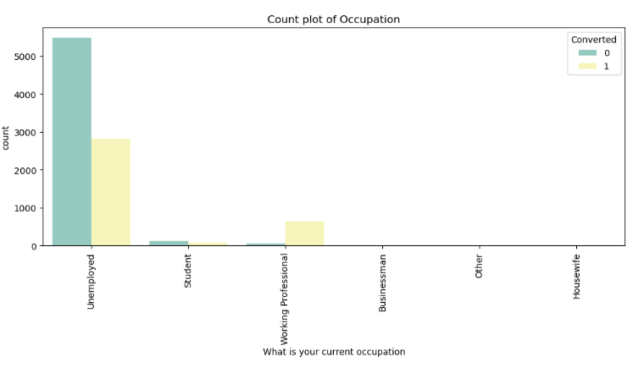
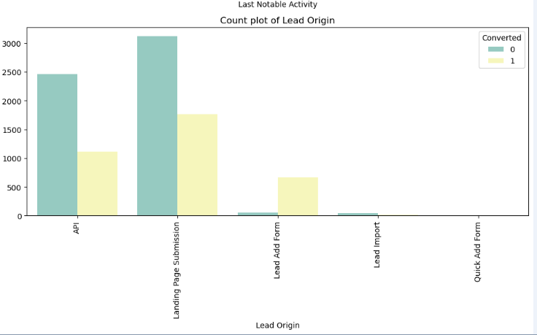
Bivariate analysis
Conversion rate of working professionals to hot leads is higher
Unemployed leads however contribute to the significant amount of both converted and not converted leads
Lead ADD form has the highest conversion ratio
API and landing page contribute a large amount of conversion but they also contribute to significantly larger count of not converted.

Slide 11
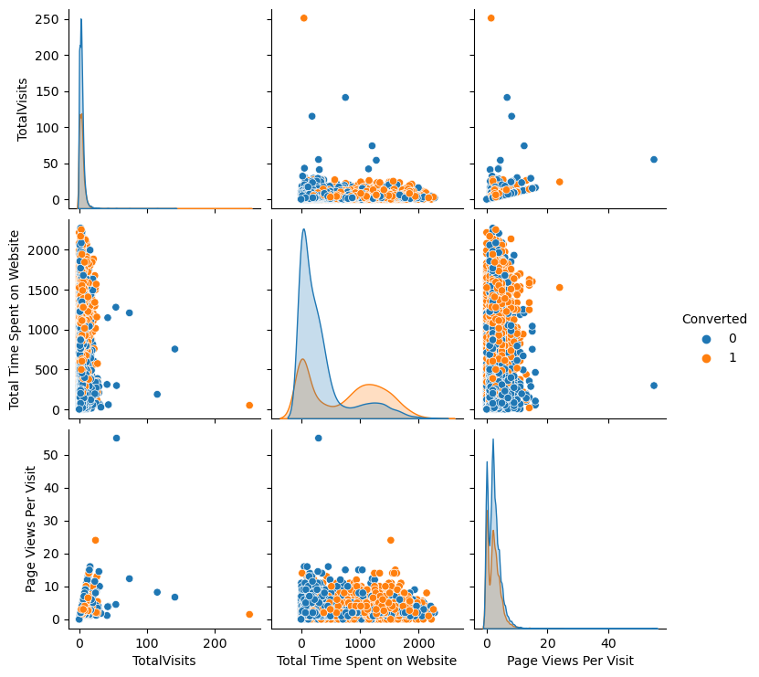
Multivariate analysis
People who have lower number Total visits but higher time spend on the website are showing higher conversion rate.

Slide 12
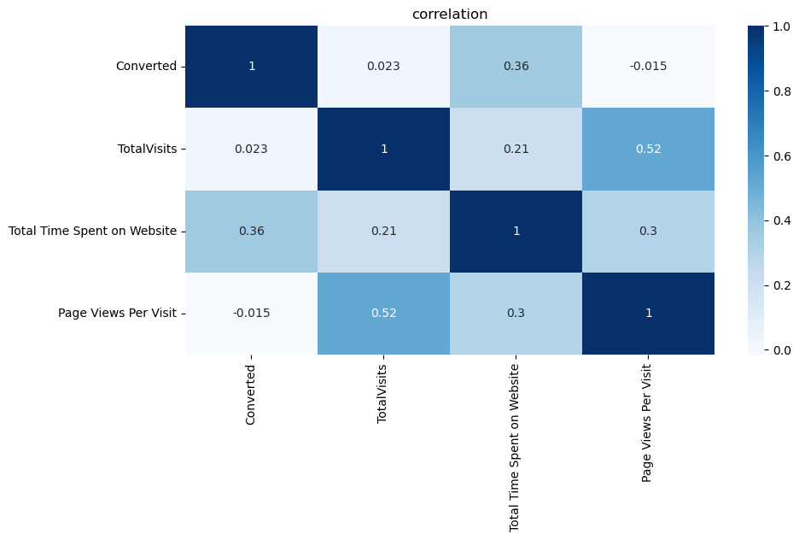
Correlation Matrix
The correlation matrix is showing slightly higher correlation of 0.52 between page views per visit and total visits
Total time spend on Website is showing moderate 0.36 correlation between converted

Slide 13
Data preparation
All the ‘Yes’ and ‘No’ are converted into 0s and 1s respectively
The redundant factors are removed by checking correlation matrix and using domain knowledge
Dummy variables are created for categorical variables
The data set is split into test and train data sets 70% train and 30% test data
The data set is scaled using Standard Scaler

Slide 14
Modelling
The prepared data is taken for logistic regression
Initial steps of RFE is done and the feature limit is set to 15
After RFE the data is a 1st model is trained using logistic regression with the 15 columns
VIF And P values are checked for the model and feature which is having high VIF values(>5) or p values (>0.05) is removed one by one
The model is again trained on the data set with the removed feature and this process is repeated till all the all the feature’s VIF and P-values are within acceptable range

Slide 15
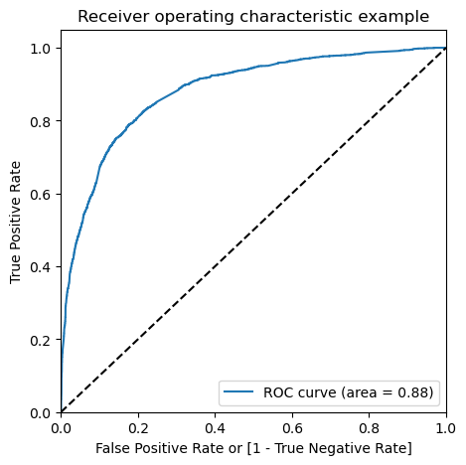
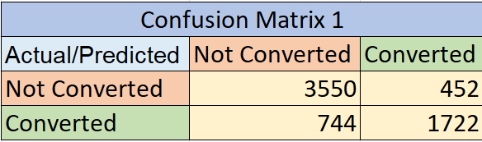
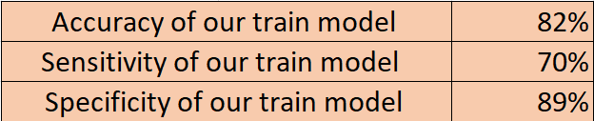
MODEL Evaluation
Based on default of 0.5 cut off we are getting the following results
ROC CURVE
ROC curve area is 0.88 which indicates it is a good model

Slide 16
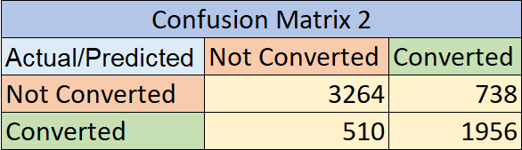
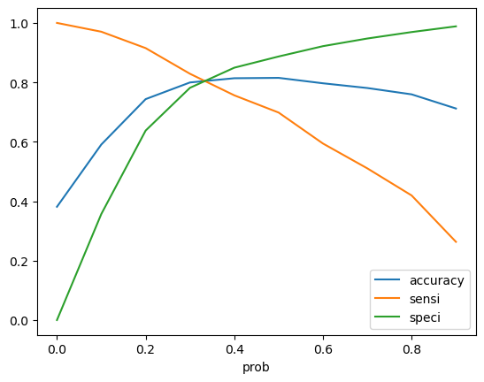
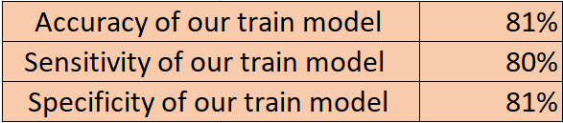

MODEL EVALUATION
Model scores based on the cutoff of 0.35 the graph of accuracy sensitivity and specificity

Slide 17
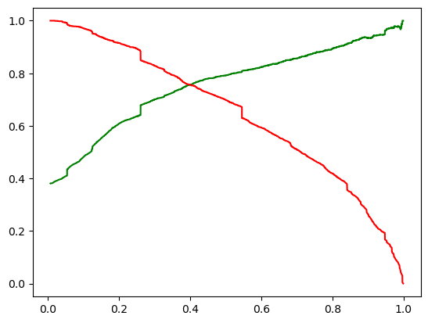
Precision Recall curve
From the precision-recall curve we are getting a value of 0.4 for cut-off
Precision Recall Curve

Slide 18

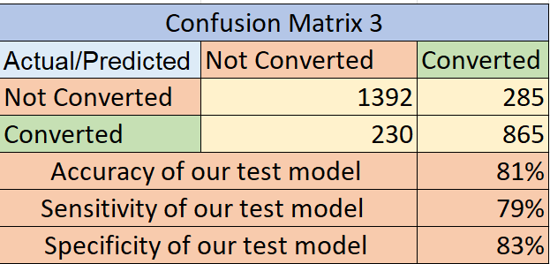

PREDICTIONS ON TEST SET
Based on decision on 0.35 as optimal cutoff the model score are shown
Area under ROC curve is 0.88 indicating a good model

Slide 19
Interpretations
We are getting a model with the following
On train data :
Accuracy : 81%
Sensitivity : 80%
Specificity :81%
Precision Score:72%
Recall Score:79%
On test data:
Accuracy : 81%
Sensitivity:79%
Specificity:83%
Precision Score:75%
Recall Score 79%
The model consistently performs well across different evaluation metrics for both training and test datasets. This means that the model is reliable, avoids overfitting, and generalizes effectively to new data. The absence of significant biases in its predictions further supports its positive performance. Overall, this indicates that the model is consistently accurate and trustworthy.

Slide 20
Insights and recommendation
After clearing the data we can check for the skewness and it is recommended to remove the columns that have high skewness so that the model can be stable and more accurate
Most of the data (99%) lies within the range and only some data lies outside and which can be found out by using the outliers
Google has contributed most for getting the leads to convert which is then proceeded by direct traffic.
Most of the leads belongs to the unemployed occupation, working professional and student stood at 2 and 3 position respectively

Slide 21
India is the country with most leads and it stood at about 96% of the total leads from any country.
Leads from the google and direct traffic are converted the most
Total time spent on the website is directly proportional to the leads that are converted.
For model building we split the data into train test split and used the standard scaler as a scaler after that we uses the RFE and Logistic regression.
Lead Source_Google, Total Time Spent on Website and Last Notable Activity_Modified are the top three contributors in making the model stable.
Accuracy of our train model is: 82%
Sensitivity of our train model is: 70%
Specificity of our train model is: 89%
Final_Lead_Score denotes that the higher the lead score more are the chances for a person to convert into a lead

